Slide 1




Employee Attrition Prediction Using Machine Learning
Student:
Course:
Roll No:

Slide 2



Problem Statement & Objectives
Problem Statement
Project Objectives
Predict whether an employee is likely to leave the company.
Compare Logistic Regression, Decision Tree and Random Forest.
Help HR identify employees at risk before they decide to resign, allowing proactive retention efforts.
Build a predictive analytics system based on historical staff data.

Slide 3






Dataset Description
Dataset
Volume
Target Variable
Employee Attrition
1000 records
Attrition (Yes/No)
A comprehensive workforce dataset tracking personnel trends.
And 26 data columns profiling demographics & indicators.
Features: Age, Income, Department, Overtime, Job Satisfaction, etc.

Slide 4








Technologies Used
Core Language
Data Analysis
Visuals & ML
Development
Python
NumPy & Pandas
Matplotlib & Scikit-learn
Jupyter Notebook / VS Code

Slide 5
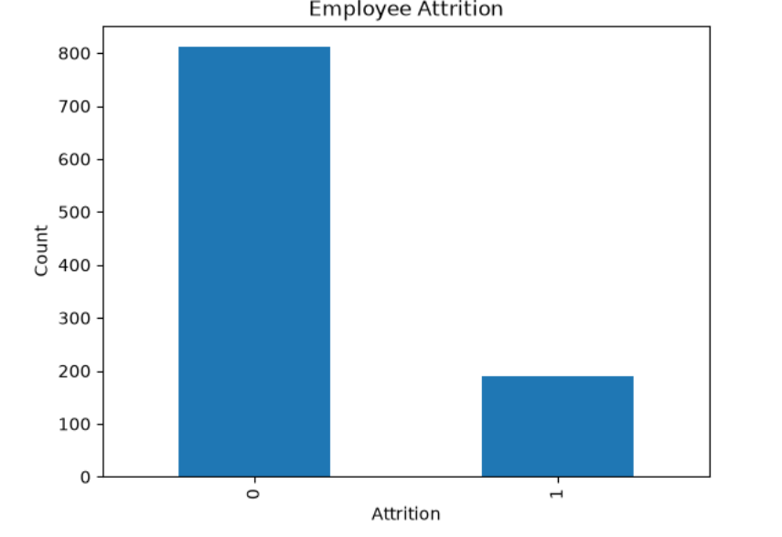

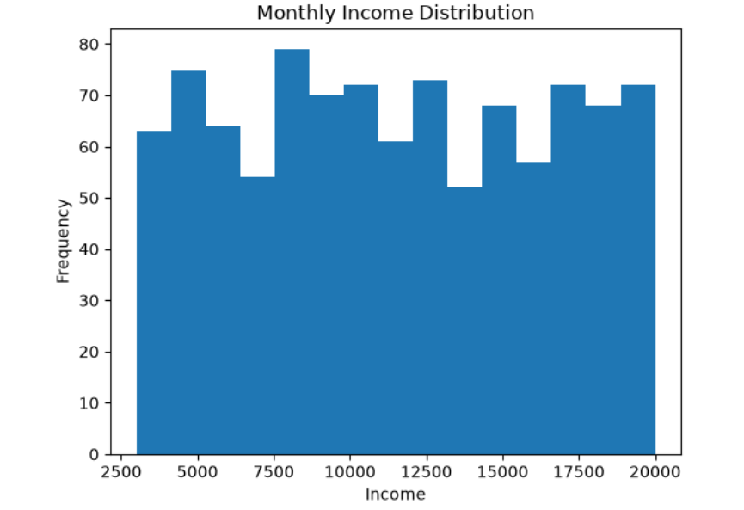
EDA & Visualizations
Employee Attrition: Analysis of general attrition rates and organizational flight counts.
Monthly Income Distribution: Mapping correlation between monthly earnings and employee attrition tendencies.
Overtime: Identifying relationships between overtime tracking metrics and employee turnover rates.

Slide 6




Machine Learning Algorithms
Supervised Classifiers
Data Validation
1. Logistic Regression: Establishes baseline statistical probability for employee flight risks.
Train-Test Split: 80:20
The attrition dataset was cleanly partitioned into an 80% validation split for training purposes and a 20% independent slice for evaluation.
2. Decision Tree: Employs structured rule-based trees mapping out splits in criteria.
3. Random Forest: Resolves overfitting issues via high-performing decision ensembles.
This ensures robust generalization and prevents overtraining anomalies during fitting cycles.

Slide 7
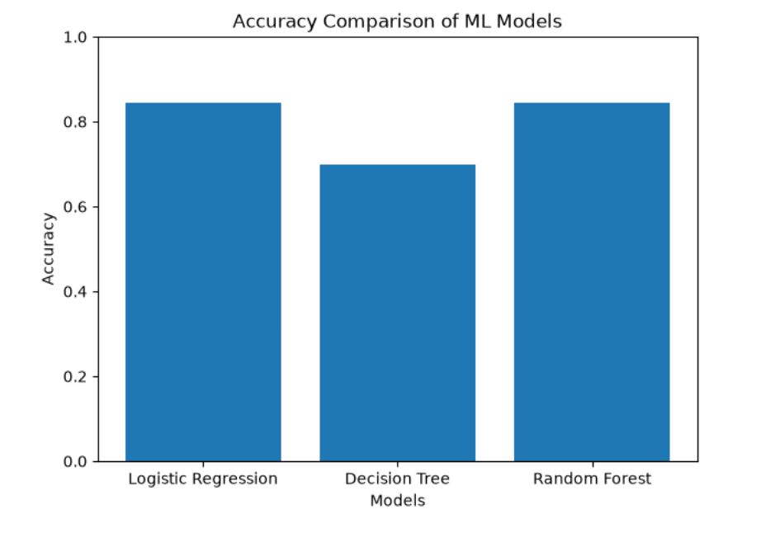
Model Evaluation & Comparison
Compare Accuracy Across Algorithms
Highlight: Random Forest is identified as the best-performing model.

Slide 8


Prediction Results
Predictive Engine
Input employee details: Enter continuous feature parameters.
Model predicts: Output class designation based on data.
0 = Employee Stays: Stable retention prediction classification.
1 = Employee Leaves: Attrition/flight hazard warning category.

Slide 9
Conclusion & Future Scope
Key Conclusions
Future Scope
Random Forest generally provides the best performance.
Hyperparameter tuning to further improve individual model accuracy boundaries.
Machine learning can support HR decision making by highlighting risk segments accurately.
Web application deployment for live use by HR administration teams.
Integrating larger datasets to enhance generalization capabilities of ensembles.

Slide 10
Thank You

